Slide 1
Transcription factor binding motifs
Prof. William Stafford Noble
GENOME 541
wnoble@uw.edu

Slide 2
Outline
Representing motifs
Motif discovery
Gibbs sampling
MEME
Scanning for motif occurrences
Multiple testing correction

Slide 3
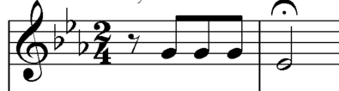
Motif (n): a succession of notes that has some special importance in or is characteristic of a composition

Slide 4
Motif (n): a recurring genomic or protein sequence pattern
TCCACGGC

Slide 5
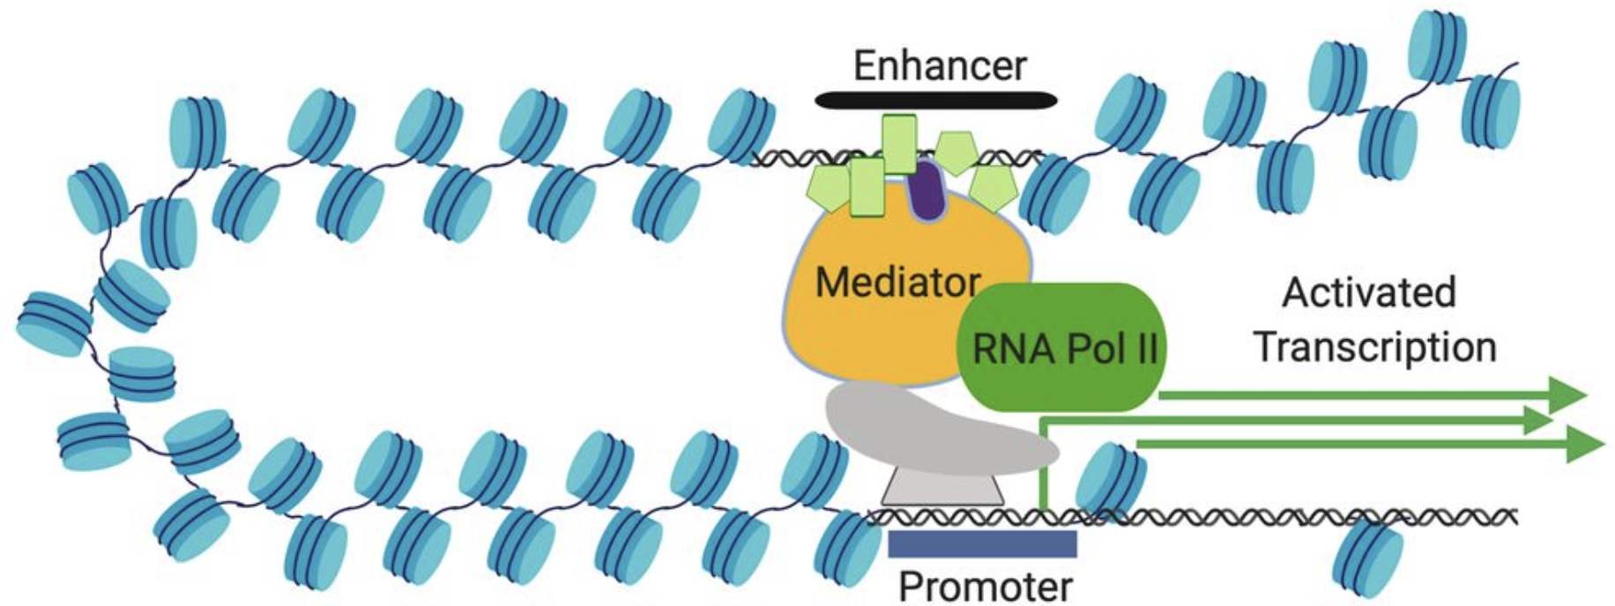
Sequence-specific transcription factors drive gene regulation
Small & Arnosti, Genetics 2020

Slide 6
Motif discovery problem
Given sequences
Find motif
seq. 1
seq. 2
seq. 3
AATTGT at position 515
ATCTGT at position 430
AAATGA at position 682
seq. 1
seq. 2
seq. 3

Slide 7
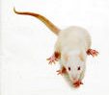

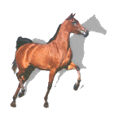
Motif discovery problem (harder version)
Given:
a sequence or family of sequences.
Find:
the number of motifs
the width of each motif
the locations of motif occurrences

Slide 8
Why is this hard?
Input sequences are long (thousands or millions of residues).
Motif may be subtle
Instances are short.
Instances are only slightly similar.

Slide 9
The most common model of sequence motifs is the position-specific scoring matrix
1 2 3 4 5 6
A 1.32 1.32 -0.15 -3.32 -3.32 -0.15
C -3.32 -3.32 -1.00 -3.32 -3.32 -3.32
G -3.32 -1.00 -1.00 -3.32 1.89 -3.32
T 0.38 -0.15 1.07 1.89 -3.32 1.54

Slide 10
Log-odds score
The nucleotide was generated by the foreground model (i.e., the PSSM).
The nucleotide A is observed.
Estimate the probability of observing each nucleotide.
Divide by the background probability of observing the same nucleotide.
Take the log so that the scores are additive.
The nucleotide was generated by the background model (i.e., randomly selected).

Slide 11
Representing motifs as PSSMs
AAGTGT
TAATGT
AATTGT
AATTGA
ATCTGT
AATTGT
TGTTGT
AAATGA
TTTTGT
A 6 6 2 0 0 2
C 0 0 1 0 0 0
G 0 1 1 0 9 0
T 3 2 5 9 0 7
A 6.25 6.25 2.25 0.25 0.25 2.25
C 0.25 0.25 1.25 0.25 0.25 0.25
G 0.25 1.25 1.25 0.25 9.25 0.25
T 3.25 2.25 5.25 9.25 0.25 7.25
Add a pseudocount.
Convert to frequencies.
Divide by background
Take the logarithm.
A 0.625 0.625 0.225 0.025 0.025 0.225
C 0.025 0.025 0.125 0.025 0.025 0.025
G 0.025 0.125 0.125 0.025 0.925 0.025
T 0.325 0.225 0.525 0.925 0.025 0.725
A 2.500 2.500 0.900 0.100 0.100 0.900
C 0.100 0.100 0.500 0.100 0.100 0.100
G 0.100 0.500 0.500 0.100 3.700 0.100
T 1.300 0.900 2.100 3.700 0.100 2.900
A 1.32 1.32 -0.15 -3.32 -3.32 -0.15
C -3.32 -3.32 -1.00 -3.32 -3.32 -3.32
G -3.32 -1.00 -1.00 -3.32 1.89 -3.32
T 0.38 -0.15 1.07 1.89 -3.32 1.54

Slide 12
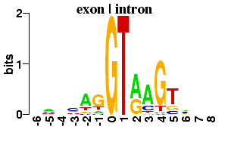
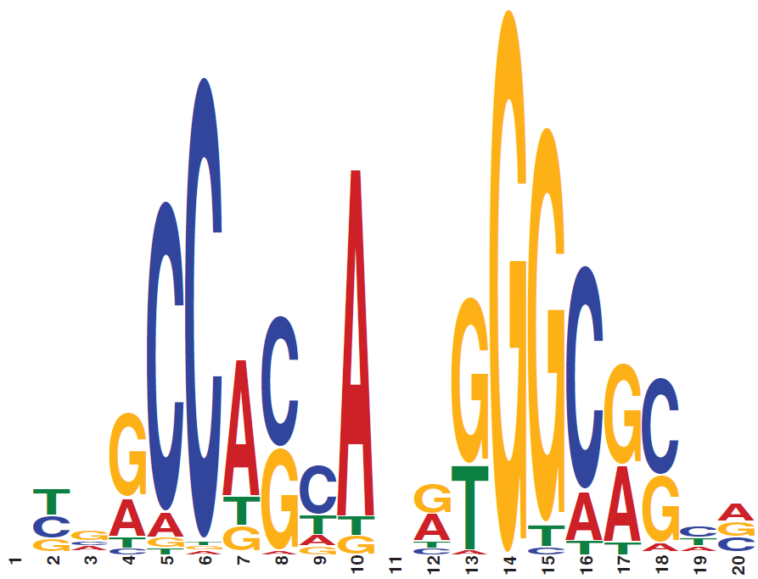
Motif logos scale letters by relative entropy
Splice site motif
p_{i,α} = probability of α in matrix position i
b_{α} = background frequency of α
CTCF binding motif

Slide 13
Outline
Representing motifs
Motif discovery
Gibbs sampling
MEME
Scanning for motif occurrences
Multiple testing correction

Slide 14
Gibbs sampling
Lawrence et al. “Detecting subtle sequence signals: A Gibbs sampling strategy for multiple alignment.” Science 1993

Slide 15
Alternating approach
Guess locations of motif instances
Use instances to predict a weight matrix
Use weight matrix to predict instances in the input sequences
Repeat 2 & 3 until satisfied.

Slide 16
Step 1: Randomly guess the positions (and strands) of the sites.
5’- TCTCTCTCCACGGCTAATTAGGTGATCATGAAAAAATGAAAAATTCATGAGAAAAGAGTCAGACATCGAAACATACAT
…HIS7
5’- ATGGCAGAATCACTTTAAAACGTGGCCCCACCCGCTGCACCCTGTGCATTTTGTACGTTACTGCGAAATGACTCAACG
…ARO4
5’- CACATCCAACGAATCACCTCACCGTTATCGTGACTCACTTTCTTTCGCATCGCCGAAGTGCCATAAAAAATATTTTTT
…ILV6
5’- TGCGAACAAAAGAGTCATTACAACGAGGAAATAGAAGAAAATGAAAAATTTTCGACAAAATGTATAGTCATTTCTATC
…THR4
5’- ACAAAGGTACCTTCCTGGCCAATCTCACAGATTTAATATAGTAAATTGTCATGCATATGACTCATCCCGAACATGAAA
…ARO1
5’- ATTGATTGACTCATTTTCCTCTGACTACTACCAGTTCAAAATGTTAGAGAAAAATAGAAAAGCAGAAAAAATAAATAA
…HOM2
5’- GGCGCCACAGTCCGCGTTTGGTTATCCGGCTGACTCATTCTGACTCTTTTTTGGAAAGTGTGGCATGTGCTTCACACA
…PRO3

Slide 17
Step 2: Randomly discard one of the sites.
5’- TCTCTCTCCACGGCTAATTAGGTGATCATGAAAAAATGAAAAATTCATGAGAAAAGAGTCAGACATCGAAACATACAT
…HIS7
5’- ATGGCAGAATCACTTTAAAACGTGGCCCCACCCGCTGCACCCTGTGCATTTTGTACGTTACTGCGAAATGACTCAACG
…ARO4
5’- CACATCCAACGAATCACCTCACCGTTATCGTGACTCACTTTCTTTCGCATCGCCGAAGTGCCATAAAAAATATTTTTT
…ILV6
5’- TGCGAACAAAAGAGTCATTACAACGAGGAAATAGAAGAAAATGAAAAATTTTCGACAAAATGTATAGTCATTTCTATC
…THR4
5’- ACAAAGGTACCTTCCTGGCCAATCTCACAGATTTAATATAGTAAATTGTCATGCATATGACTCATCCCGAACATGAAA
…ARO1
5’- ATTGATTGACTCATTTTCCTCTGACTACTACCAGTTCAAAATGTTAGAGAAAAATAGAAAAGCAGAAAAAATAAATAA
…HOM2
5’- GGCGCCACAGTCCGCGTTTGGTTATCCGGCTGACTCATTCTGACTCTTTTTTGGAAAGTGTGGCATGTGCTTCACACA
…PRO3

Slide 18
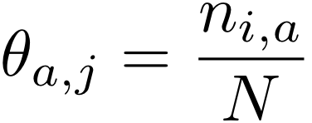

Step 3: Build a PSSM from the remaining sites
Alignment
Count Matrix
PSSM
1 AAAATTCATG
2 ACGTTACTGC
A
C
G
T
A
C
G
T
i
CACCGTTATC
AAAAGAGTCA
CAGTTCAAAA
N GGTTATCCGG
12 … w
j
12 … w
12 … w
5’- TCTCTCTCCACGGCTAATTAGGTGATCATGAAAAAATGAAAAATTCATGAGAAAAGAGTCAGACATCGAAACATACAT
…HIS7
5’- ATGGCAGAATCACTTTAAAACGTGGCCCCACCCGCTGCACCCTGTGCATTTTGTACGTTACTGCGAAATGACTCAACG
…ARO4
5’- CACATCCAACGAATCACCTCACCGTTATCGTGACTCACTTTCTTTCGCATCGCCGAAGTGCCATAAAAAATATTTTTT
…ILV6
5’- TGCGAACAAAAGAGTCATTACAACGAGGAAATAGAAGAAAATGAAAAATTTTCGACAAAATGTATAGTCATTTCTATC
…THR4
5’- ACAAAGGTACCTTCCTGGCCAATCTCACAGATTTAATATAGTAAATTGTCATGCATATGACTCATCCCGAACATGAAA
…ARO1
5’- ATTGATTGACTCATTTTCCTCTGACTACTACCAGTTCAAAATGTTAGAGAAAAATAGAAAAGCAGAAAAAATAAATAA
…HOM2
5’- GGCGCCACAGTCCGCGTTTGGTTATCCGGCTGACTCATTCTGACTCTTTTTTGGAAAGTGTGGCATGTGCTTCACACA
…PRO3

Slide 19
Step 4: Scan the held-out sequence with the new PSSM
Normalize the scores to be non-negative and sum to 1
Score
5’- ACAAAGGTACCTTCCTGGCCAATCTCACAGATTTAATATAGTAAATTGTCATGCATATGACTCATCCCGAACATGAAA
…ARO1
Position in sequence

Slide 20
Step 5: Probabilistically select a new motif instance
Score
5’- ACAAAGGTACCTTCCTGGCCAATCTCACAGATTTAATATAGTAAATTGTCATGCATATGACTCATCCCGAACATGAAA
…ARO1
Position in sequence
ACGAAGT: 11%
ACGCCGT:20%
ACGGCGT:52%

Slide 21
Return to step 2, randomly discarding a site
5’- TCTCTCTCCACGGCTAATTAGGTGATCATGAAAAAATGAAAAATTCATGAGAAAAGAGTCAGACATCGAAACATACAT
…HIS7
5’- ATGGCAGAATCACTTTAAAACGTGGCCCCACCCGCTGCACCCTGTGCATTTTGTACGTTACTGCGAAATGACTCAACG
…ARO4
5’- CACATCCAACGAATCACCTCACCGTTATCGTGACTCACTTTCTTTCGCATCGCCGAAGTGCCATAAAAAATATTTTTT
…ILV6
5’- TGCGAACAAAAGAGTCATTACAACGAGGAAATAGAAGAAAATGAAAAATTTTCGACAAAATGTATAGTCATTTCTATC
…THR4
5’- ACAAAGGTACCTTCCTGGCCAATCTCACAGATTTAATATAGTAAATTGTCATGCATATGACTCATCCCGAACATGAAA
…ARO1
5’- ATTGATTGACTCATTTTCCTCTGACTACTACCAGTTCAAAATGTTAGAGAAAAATAGAAAAGCAGAAAAAATAAATAA
…HOM2
5’- GGCGCCACAGTCCGCGTTTGGTTATCCGGCTGACTCATTCTGACTCTTTTTTGGAAAGTGTGGCATGTGCTTCACACA
…PRO3

Slide 22
Gibbs sampler
Randomly guess an instance from input sequence.
Throw away a randomly selected sequence s*.
Use the remaining instances to define a PSSM.
Use the PSSM to scan the sequence s*, defining an instance probability at each position.
Pick a new instance from s* according to the probability distribution.
If we haven’t reached the maximum number of iterations, return to step 2.
Return the highest-scoring motif seen.

Slide 23
MEME
Bailey and Elkan. “Fitting a mixture model by expectation-maximization to discover motifs in biopolymers.” ISMB 1994.

Slide 24
Alternating approach
Guess locations of motif instances
Use instances to predict a weight matrix
Use weight matrix to predict instances in the input sequences
Repeat 2 & 3 until satisfied.

Slide 25
Step 1: Randomly guess the positions of the sites.
5’- TCTCTCTCCACGGCTAATTAGGTGATCATGAAAAAATGAAAAATTCATGAGAAAAGAGTCAGACATCGAAACATACAT
…HIS7
5’- ATGGCAGAATCACTTTAAAACGTGGCCCCACCCGCTGCACCCTGTGCATTTTGTACGTTACTGCGAAATGACTCAACG
…ARO4
5’- CACATCCAACGAATCACCTCACCGTTATCGTGACTCACTTTCTTTCGCATCGCCGAAGTGCCATAAAAAATATTTTTT
…ILV6
5’- TGCGAACAAAAGAGTCATTACAACGAGGAAATAGAAGAAAATGAAAAATTTTCGACAAAATGTATAGTCATTTCTATC
…THR4
5’- ACAAAGGTACCTTCCTGGCCAATCTCACAGATTTAATATAGTAAATTGTCATGCATATGACTCATCCCGAACATGAAA
…ARO1
5’- ATTGATTGACTCATTTTCCTCTGACTACTACCAGTTCAAAATGTTAGAGAAAAATAGAAAAGCAGAAAAAATAAATAA
…HOM2
5’- GGCGCCACAGTCCGCGTTTGGTTATCCGGCTGACTCATTCTGACTCTTTTTTGGAAAGTGTGGCATGTGCTTCACACA
…PRO3

Slide 26
Step 2: Build a PSSM from the sites
Alignment
Count Matrix
PSSM
1 AAAATTCATG
2 ACGTTACTGC
A
C
G
T
A
C
G
T
i
CACCGTTATC
AAAAGAGTCA
CAGTTCAAAA
N GGTTATCCGG
12 … w
j
12 … w
12 … w
5’- TCTCTCTCCACGGCTAATTAGGTGATCATGAAAAAATGAAAAATTCATGAGAAAAGAGTCAGACATCGAAACATACAT
…HIS7
5’- ATGGCAGAATCACTTTAAAACGTGGCCCCACCCGCTGCACCCTGTGCATTTTGTACGTTACTGCGAAATGACTCAACG
…ARO4
5’- CACATCCAACGAATCACCTCACCGTTATCGTGACTCACTTTCTTTCGCATCGCCGAAGTGCCATAAAAAATATTTTTT
…ILV6
5’- TGCGAACAAAAGAGTCATTACAACGAGGAAATAGAAGAAAATGAAAAATTTTCGACAAAATGTATAGTCATTTCTATC
…THR4
5’- ACAAAGGTACCTTCCTGGCCAATCTCACAGATTTAATATAGTAAATTGTCATGCATATGACTCATCCCGAACATGAAA
…ARO1
5’- ATTGATTGACTCATTTTCCTCTGACTACTACCAGTTCAAAATGTTAGAGAAAAATAGAAAAGCAGAAAAAATAAATAA
…HOM2
5’- GGCGCCACAGTCCGCGTTTGGTTATCCGGCTGACTCATTCTGACTCTTTTTTGGAAAGTGTGGCATGTGCTTCACACA
…PRO3

Slide 27
Step 3: Scan each sequence with the PSSM and find the best-scoring site
A
C
G
T
5’- TCTCTCTCCACGGCTAATTAGGTGATCATGAAAAAATGAAAAATTCATGAGAAAAGAGTCAGACATCGAAACATACAT
…HIS7
5’- ATGGCAGAATCACTTTAAAACGTGGCCCCACCCGCTGCACCCTGTGCATTTTGTACGTTACTGCGAAATGACTCAACG
…ARO4
5’- CACATCCAACGAATCACCTCACCGTTATCGTGACTCACTTTCTTTCGCATCGCCGAAGTGCCATAAAAAATATTTTTT
…ILV6
5’- TGCGAACAAAAGAGTCATTACAACGAGGAAATAGAAGAAAATGAAAAATTTTCGACAAAATGTATAGTCATTTCTATC
…THR4
5’- ACAAAGGTACCTTCCTGGCCAATCTCACAGATTTAATATAGTAAATTGTCATGCATATGACTCATCCCGAACATGAAA
…ARO1
5’- ATTGATTGACTCATTTTCCTCTGACTACTACCAGTTCAAAATGTTAGAGAAAAATAGAAAAGCAGAAAAAATAAATAA
…HOM2
5’- GGCGCCACAGTCCGCGTTTGGTTATCCGGCTGACTCATTCTGACTCTTTTTTGGAAAGTGTGGCATGTGCTTCACACA
…PRO3

Slide 28
Step 4: If the selected sites are the same, stop. Otherwise, return to step 2.
5’- TCTCTCTCCACGGCTAATTAGGTGATCATGAAAAAATGAAAAATTCATGAGAAAAGAGTCAGACATCGAAACATACAT
…HIS7
5’- ATGGCAGAATCACTTTAAAACGTGGCCCCACCCGCTGCACCCTGTGCATTTTGTACGTTACTGCGAAATGACTCAACG
…ARO4
5’- CACATCCAACGAATCACCTCACCGTTATCGTGACTCACTTTCTTTCGCATCGCCGAAGTGCCATAAAAAATATTTTTT
…ILV6
5’- TGCGAACAAAAGAGTCATTACAACGAGGAAATAGAAGAAAATGAAAAATTTTCGACAAAATGTATAGTCATTTCTATC
…THR4
5’- ACAAAGGTACCTTCCTGGCCAATCTCACAGATTTAATATAGTAAATTGTCATGCATATGACTCATCCCGAACATGAAA
…ARO1
5’- ATTGATTGACTCATTTTCCTCTGACTACTACCAGTTCAAAATGTTAGAGAAAAATAGAAAAGCAGAAAAAATAAATAA
…HOM2
5’- GGCGCCACAGTCCGCGTTTGGTTATCCGGCTGACTCATTCTGACTCTTTTTTGGAAAGTGTGGCATGTGCTTCACACA
…PRO3
5’- TCTCTCTCCACGGCTAATTAGGTGATCATGAAAAAATGAAAAATTCATGAGAAAAGAGTCAGACATCGAAACATACAT
…HIS7
5’- ATGGCAGAATCACTTTAAAACGTGGCCCCACCCGCTGCACCCTGTGCATTTTGTACGTTACTGCGAAATGACTCAACG
…ARO4
5’- CACATCCAACGAATCACCTCACCGTTATCGTGACTCACTTTCTTTCGCATCGCCGAAGTGCCATAAAAAATATTTTTT
…ILV6
5’- TGCGAACAAAAGAGTCATTACAACGAGGAAATAGAAGAAAATGAAAAATTTTCGACAAAATGTATAGTCATTTCTATC
…THR4
5’- ACAAAGGTACCTTCCTGGCCAATCTCACAGATTTAATATAGTAAATTGTCATGCATATGACTCATCCCGAACATGAAA
…ARO1
5’- ATTGATTGACTCATTTTCCTCTGACTACTACCAGTTCAAAATGTTAGAGAAAAATAGAAAAGCAGAAAAAATAAATAA
…HOM2
5’- GGCGCCACAGTCCGCGTTTGGTTATCCGGCTGACTCATTCTGACTCTTTTTTGGAAAGTGTGGCATGTGCTTCACACA
…PRO3

Slide 29
How does MEME avoid finding a local minimum?

Slide 30
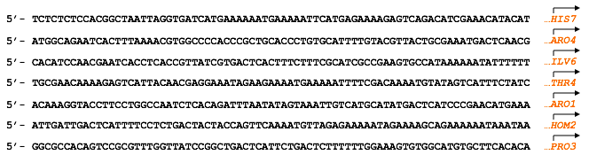
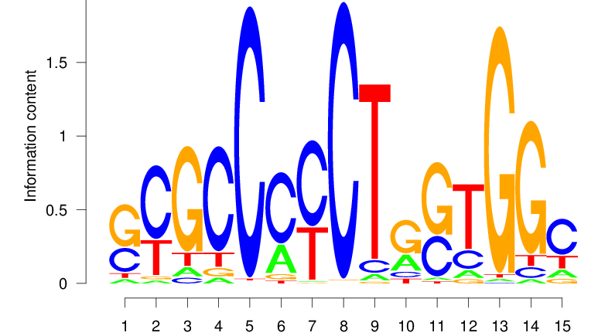
Heuristic selection of starting points
1 2 3 4 5
A
C
G
T
0.17 0.17 0.17 0.5 0.5
0.17 0.5 0.17 0.17 0.17
0.5 0.17 0.17 0.17 0.17
0.17 0.17 0.5 0.17 0.17
One round of EM
Choose highest-likelihood initializations
run EM to convergence

Slide 31
The full MEME algorithm is more complex
Consider various widths
do
for (width = min; width *= √2; width < max)
for each possible starting point
run 1 iteration of EM
select candidate starting points
for each candidate
run EM to convergence
select best motif
erase motif occurrences
until (motif score < threshold)
Heuristic to speed things up
Find multiple motifs in one data set

Slide 32
Comparison of EM and Gibbs sampling
Both iterate over two steps:
Guess locations of motif instances
Use instances to predict a weight matrix
Use weight matrix to predict instances in the input sequences
Repeat 2 & 3 until satisfied.
Convergence:
EM converges when the PSSM stops changing.
Gibbs sampling runs until you ask it to stop.
Solution:
EM may not find the motif with the highest score.
Gibbs sampling will provably find the motif with the highest score, if you let it run long enough.

Slide 33
Outline
Representing motifs
Motif discovery
Gibbs sampling
MEME
Scanning for motif occurrences
Multiple testing correction

Slide 34
Scanning for motifs
Grant et al. “FIMO: Scanning for occurrences of a given motif.” Bioinformatics 2011.

Slide 35
Scanning for motif occurrences
Given:
a long DNA sequence, and
TAATGTTTGTGCTGGTTTTTGTGGCATCGGGCGAGAATAGCGCGTGGTGTGAAAG
a DNA motif represented as a PSSM
Find:
occurrences of the motif in the sequence
A 1.32 1.32 -0.15 -3.32 -3.32 -0.15
C -3.32 -3.32 -1.00 -3.32 -3.32 -3.32
G -3.32 -1.00 -1.00 -3.32 1.89 -3.32
T 0.38 -0.15 1.07 1.89 -3.32 1.54

Slide 36
Scanning for motif occurrences
A 1.32 1.32 -0.15 -3.32 -3.32 -0.15
C -3.32 -3.32 -1.00 -3.32 -3.32 -3.32
G -3.32 -1.00 -1.00 -3.32 1.89 -3.32
T 0.38 -0.15 1.07 1.89 -3.32 1.54
0.38 + 1.32 – 0.15 + 1.89 + 1.89 + 1.54 = 6.87
TAATGTTTGTGCTGGTTTTTGTGGCATCGGGCGAGAATAGCGCGTGGTGTGAAAG

Slide 37
Calculate the score for the next subsequence
A 1.32 1.32 -0.15 -3.32 -3.32 -0.15
C -3.32 -3.32 -1.00 -3.32 -3.32 -3.32
G -3.32 -1.00 -1.00 -3.32 1.89 -3.32
T 0.38 -0.15 1.07 1.89 -3.32 1.54
TAATGTTTGTGCTGGTTTTTGTGGCATCGGGCGAGAATAGCGCGTGGTGTGAAAG

Slide 38
The score is -1.39.
A 1.32 1.32 -0.15 -3.32 -3.32 -0.15
C -3.32 -3.32 -1.00 -3.32 -3.32 -3.32
G -3.32 -1.00 -1.00 -3.32 1.89 -3.32
T 0.38 -0.15 1.07 1.89 -3.32 1.54
1.32 + 1.32 + 1.07 – 3.32 – 3.32 + 1.54 = -1.39
TAATGTTTGTGCTGGTTTTTGTGGCATCGGGCGAGAATAGCGCGTGGTGTGAAAG

Slide 39
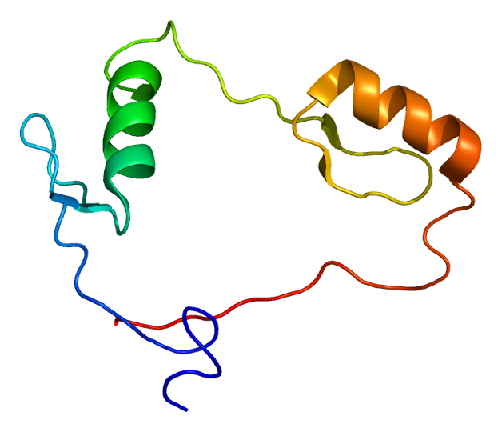
CTCF
One of the most important transcription factors in human cells.
Responsible both for turning genes on and for maintaining 3D structure of the DNA.

Slide 40
CTCF binds to a long sequence motif

Slide 41
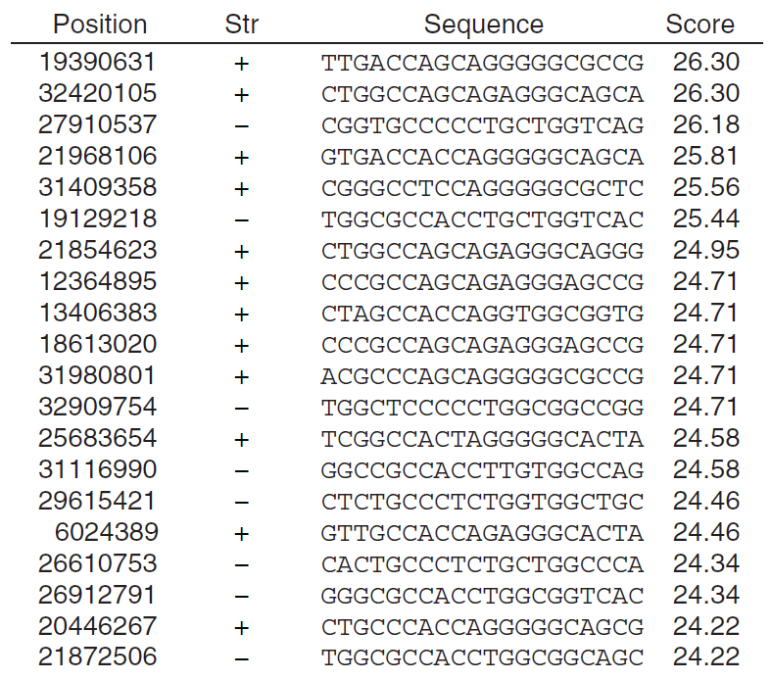
Searching human chromosome 21 with the CTCF motif

Slide 42

Significance of scores
Motif
scanning
algorithm
26.30
Low score = not a motif occurrence
High score = motif occurrence
How high is high enough?
TTGACCAGCAGGGGGCGCCG

Slide 43
Two way to assess significance
Empirical
Randomly generate data according to the null hypothesis.
Use the resulting score distribution to estimate p-values.
Exact
Mathematically calculate all possible scores
Use the resulting score distribution to estimate p-values.

Slide 44
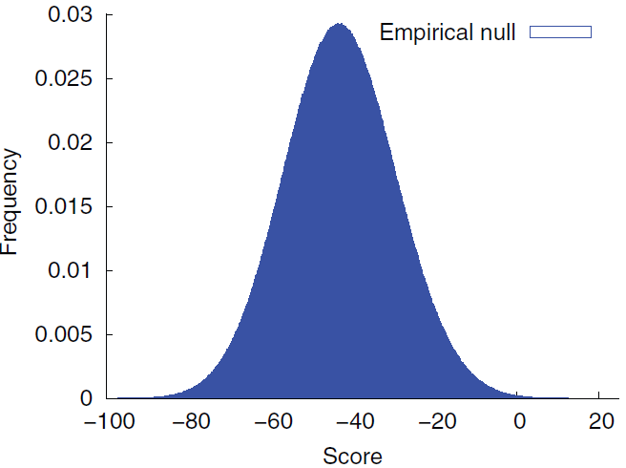
CTCF empirical null distribution

Slide 45
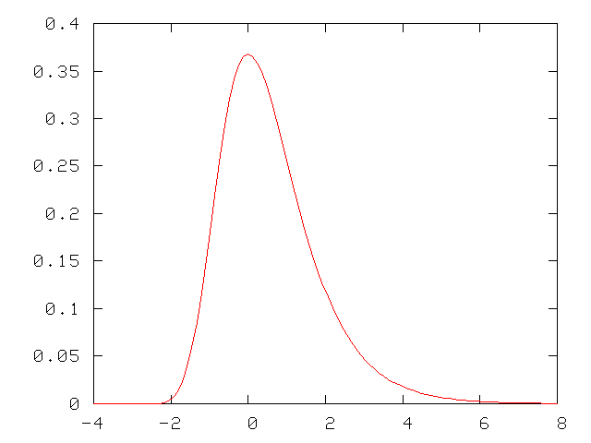
Computing a p-value
The probability of observing a score >= 4 is the area under the curve to the right of 4.
This probability is called a p-value.
p-value = Pr(data|null)

Slide 46
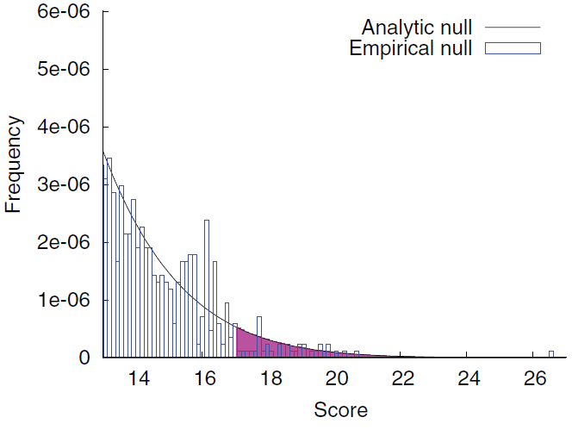
Empirical null yields poor estimates in the tail

Slide 47
We can use dynamic programming to compute the analytical null for a given motif

Slide 48
Converting scores to p-values
A -2.3 1.7 1.1 0.1
C 1.2 -0.3 0.4 -1.0
G -3.0 2.0 0.5 0.8
T 4.0 0.0 -2.1 1.5
A 10 67 59 44
C 60 39 49 29
G 0 71 50 54
T 100 43 13 64
Linearly rescale the matrix values to the range [0,100] and integerize.

Slide 49
Dynamic programming on motif scores
0 1 2 3 4 … 50
 | 1 | 2 | 3 | 4 | 5
A | 10 | 0 | 4 | 6 | 8
C | 2 | 7 | 4 | 8 | 5
G | 5 | 3 | 7 | 10 | 0
T | 8 | 2 | 1 | 0 | 5
For simplicity, I have scaled this motif to 10 rather than 100.
Say that your motif has N=5 columns. Create a matrix that has 5 rows and 10N=50 columns.
The entry in row i, column j is a count of the number of different sequences of length i that can have a score of j.

Slide 50
Dynamic programming for motif p-values
Motif score
0 | 1 | 2 | 3 | 4 | 5 | 6 | 7 | 8 | 9 | 10 | 11 | 12 | 13 | 14 | 15 | 16 | 17 | 18 | 19 | 20 | 21 | 22 | 23 | 24 | 25 | 26 | 27 | 28 | 29 | 30 | 31 | 32 | 33 | 34 | 35 | 36 | 37 | 38 | 39 | 40 | 41 | 42 | 43 | 44 | 45 | 46 | 47 | 48 | 49 | 50
1
2
3
4
5
Position in motif
 | 1 | 2 | 3 | 4 | 5
A | 10 | 0 | 4 | 6 | 8
C | 2 | 7 | 4 | 8 | 5
G | 5 | 3 | 7 | 10 | 0
T | 8 | 2 | 1 | 0 | 5
Score all length-1 sequences

Slide 51
Dynamic programming for motif p-values
Motif score
0 | 1 | 2 | 3 | 4 | 5 | 6 | 7 | 8 | 9 | 10 | 11 | 12 | 13 | 14 | 15 | 16 | 17 | 18 | 19 | 20 | 21 | 22 | 23 | 24 | 25 | 26 | 27 | 28 | 29 | 30 | 31 | 32 | 33 | 34 | 35 | 36 | 37 | 38 | 39 | 40 | 41 | 42 | 43 | 44 | 45 | 46 | 47 | 48 | 49 | 50
 |  | 1 |  |  | 1 |  |  | 1 |  | 1
1
2
3
4
5
Position in motif
Score all length-2 sequences starting with C
 | 1 | 2 | 3 | 4 | 5
A | 10 | 0 | 4 | 6 | 8
C | 2 | 7 | 4 | 8 | 5
G | 5 | 3 | 7 | 10 | 0
T | 8 | 2 | 1 | 0 | 5

Slide 52
Dynamic programming for motif p-values
Motif score
0 | 1 | 2 | 3 | 4 | 5 | 6 | 7 | 8 | 9 | 10 | 11 | 12 | 13 | 14 | 15 | 16 | 17 | 18 | 19 | 20 | 21 | 22 | 23 | 24 | 25 | 26 | 27 | 28 | 29 | 30 | 31 | 32 | 33 | 34 | 35 | 36 | 37 | 38 | 39 | 40 | 41 | 42 | 43 | 44 | 45 | 46 | 47 | 48 | 49 | 50
 |  | 1 |  |  | 1 |  |  | 1 |  | 1
 |  | 1 |  | 1 | 1 |  |  |  | 1
1
2
3
4
5
Position in motif
 | 1 | 2 | 3 | 4 | 5
A | 10 | 0 | 4 | 6 | 8
C | 2 | 7 | 4 | 8 | 5
G | 5 | 3 | 7 | 10 | 0
T | 8 | 2 | 1 | 0 | 5

Slide 53
General procedure for filling in one row
Motif score
To fill in values in row 2, you will use the values in
row 1 of the DP matrix, and
column 2 of the PSSM.
Select one entry in row 1 of the DP matrix. For example, the value 1 is in column 2.
Select one entry in column 2 of the PSSM. For example, the value 0.
Compute the score for your new entry by adding 0 to 2.
Add previous DP value (1) into row 2, column 2.
Repeat this procedure for each value in DP row 1 and each entry in the selected PSSM column.
0 | 1 | 2 | 3 | 4 | 5 | 6 | 7 | 8 | 9 | 10 | 11 | 12 | 13 | 14 | 15 | 16 | 17 | 18 | 19 | 20 | 21 | 22 | 23 | 24 | 25 | 26 | 27 | 28 | 29 | 30 | 31 | 32 | 33 | 34 | 35 | 36 | 37 | 38 | 39 | 40 | 41 | 42 | 43 | 44 | 45 | 46 | 47 | 48 | 49 | 50
 |  | 1 |  |  | 1 |  |  | 1 |  | 1
1
2
3
4
5
Position in motif
Score all length-2 sequences starting with C
 | 1 | 2 | 3 | 4 | 5
A | 10 | 0 | 4 | 6 | 8
C | 2 | 7 | 4 | 8 | 5
G | 5 | 3 | 7 | 10 | 0
T | 8 | 2 | 1 | 0 | 5

Slide 54
Dynamic programming for motif p-values
Motif score
0 | 1 | 2 | 3 | 4 | 5 | 6 | 7 | 8 | 9 | 10 | 11 | 12 | 13 | 14 | 15 | 16 | 17 | 18 | 19 | 20 | 21 | 22 | 23 | 24 | 25 | 26 | 27 | 28 | 29 | 30 | 31 | 32 | 33 | 34 | 35 | 36 | 37 | 38 | 39 | 40 | 41 | 42 | 43 | 44 | 45 | 46 | 47 | 48 | 49 | 50
 |  | 1 |  |  | 1 |  |  | 1 |  | 1
 |  | 1 |  | 1 | 1 |  |  |  | 1
1
2
3
4
5
Position in motif
Score all length-2 sequences starting with C or G
 | 1 | 2 | 3 | 4 | 5
A | 10 | 0 | 4 | 6 | 8
C | 2 | 7 | 4 | 8 | 5
G | 5 | 3 | 7 | 10 | 0
T | 8 | 2 | 1 | 0 | 5

Slide 55
Dynamic programming for motif p-values
Motif score
0 | 1 | 2 | 3 | 4 | 5 | 6 | 7 | 8 | 9 | 10 | 11 | 12 | 13 | 14 | 15 | 16 | 17 | 18 | 19 | 20 | 21 | 22 | 23 | 24 | 25 | 26 | 27 | 28 | 29 | 30 | 31 | 32 | 33 | 34 | 35 | 36 | 37 | 38 | 39 | 40 | 41 | 42 | 43 | 44 | 45 | 46 | 47 | 48 | 49 | 50
 |  | 1 |  |  | 1 |  |  | 1 |  | 1
 |  | 1 |  | 1 | 2 |  | 1 | 1 | 1 |  |  | 1
1
2
3
4
5
Position in motif
 | 1 | 2 | 3 | 4 | 5
A | 10 | 0 | 4 | 6 | 8
C | 2 | 7 | 4 | 8 | 5
G | 5 | 3 | 7 | 10 | 0
T | 8 | 2 | 1 | 0 | 5
Score all length-2 sequences

Slide 56
Dynamic programming for motif p-values
Motif score
0 | 1 | 2 | 3 | 4 | 5 | 6 | 7 | 8 | 9 | 10 | 11 | 12 | 13 | 14 | 15 | 16 | 17 | 18 | 19 | 20 | 21 | 22 | 23 | 24 | 25 | 26 | 27 | 28 | 29 | 30 | 31 | 32 | 33 | 34 | 35 | 36 | 37 | 38 | 39 | 40 | 41 | 42 | 43 | 44 | 45 | 46 | 47 | 48 | 49 | 50
 |  | 1 |  |  | 1 |  |  | 1 |  | 1
 |  | 1 |  | 1 | 2 |  | 1 | 2 | 1 | 2 | 1 | 2 | 1 |  | 1 |  | 1
1
2
3
4
5
Position in motif
 | 1 | 2 | 3 | 4 | 5
A | 10 | 0 | 4 | 6 | 8
C | 2 | 7 | 4 | 8 | 5
G | 5 | 3 | 7 | 10 | 0
T | 8 | 2 | 1 | 0 | 5

Slide 57
Dynamic programming for motif p-values
Motif score
0 | 1 | 2 | 3 | 4 | 5 | 6 | 7 | 8 | 9 | 10 | 11 | 12 | 13 | 14 | 15 | 16 | 17 | 18 | 19 | 20 | 21 | 22 | 23 | 24 | 25 | 26 | 27 | 28 | 29 | 30 | 31 | 32 | 33 | 34 | 35 | 36 | 37 | 38 | 39 | 40 | 41 | 42 | 43 | 44 | 45 | 46 | 47 | 48 | 49 | 50
 |  | 1 |  |  | 1 |  |  | 1 |  | 1
 |  | 1 |  | 1 | 2 |  | 1 | 2 | 1 | 2 | 1 | 2 | 1 |  | 1 |  | 1
 |  |  | 1 |  |  | 2 |  |  | 1
1
2
3
4
5
Position in motif
 | 1 | 2 | 3 | 4 | 5
A | 10 | 0 | 4 | 6 | 8
C | 2 | 7 | 4 | 8 | 5
G | 5 | 3 | 7 | 10 | 0
T | 8 | 2 | 1 | 0 | 5

Slide 58
Use the bottom row to compute p-values
Motif score
0 | 1 | 2 | 3 | 4 | 5 | 6 | 7 | 8 | 9 | 10 | 11 | 12 | 13 | 14 | 15 | 16 | 17 | 18 | 19 | 20 | 21 | 22 | 23 | 24 | 25 | 26 | 27 | 28 | 29 | 30 | 31 | 32 | 33 | 34 | 35 | 36 | 37 | 38 | 39 | 40 | 41 | 42 | 43 | 44 | 45 | 46 | 47 | 48 | 49 | 50
0 | 0 | 1 | 0 | 0 | 1 | 0 | 0 | 1 | 0 | 1 | 0 | 0 | 0 | 0 | 0 | 0 | 0 | 0 | 0 | 0 | 0 | 0 | 0 | 0 | 0 | 0 | 0 | 0 | 0 | 0 | 0 | 0 | 0 | 0 | 0 | 0 | 0 | 0 | 0 | 0 | 0 | 0 | 0 | 0 | 0 | 0 | 0 | 0 | 0 | 0
0 | 0 | 1 | 0 | 1 | 2 | 0 | 1 | 2 | 1 | 2 | 1 | 2 | 1 | 0 | 1 | 0 | 1 | 0 | 0 | 0 | 0 | 0 | 0 | 0 | 0 | 0 | 0 | 0 | 0 | 0 | 0 | 0 | 0 | 0 | 0 | 0 | 0 | 0 | 0 | 0 | 0 | 0 | 0 | 0 | 0 | 0 | 0 | 0 | 0 | 0
0 | 0 | 0 | 1 | 0 | 1 | 4 | 0 | 3 | 7 | 1 | 5 | 7 | 4 | 6 | 4 | 6 | 4 | 2 | 4 | 1 | 2 | 1 | 0 | 1 | 0 | 0 | 0 | 0 | 0 | 0 | 0 | 0 | 0 | 0 | 0 | 0 | 0 | 0 | 0 | 0 | 0 | 0 | 0 | 0 | 0 | 0 | 0 | 0 | 0 | 0
0 | 0 | 0 | 1 | 0 | 1 | 4 | 0 | 3 | 8 | 1 | 7 | 11 | 6 | 13 | 12 | 14 | 16 | 13 | 20 | 15 | 15 | 20 | 12 | 15 | 12 | 9 | 10 | 4 | 6 | 3 | 2 | 2 | 0 | 1 | 0 | 0 | 0 | 0 | 0 | 0 | 0 | 0 | 0 | 0 | 0 | 0 | 0 | 0 | 0 | 0
0 | 0 | 0 | 1 | 0 | 1 | 4 | 0 | 4 | 9 | 2 | 13 | 15 | 10 | 28 | 21 | 25 | 42 | 31 | 46 | 51 | 47 | 63 | 53 | 62 | 63 | 52 | 65 | 51 | 48 | 50 | 35 | 36 | 26 | 20 | 19 | 9 | 10 | 5 | 3 | 3 | 0 | 1 | 0 | 0 | 0 | 0 | 0 | 0 | 0 | 0
1
2
3
4
5
Position in motif
In the end, the bottom row contains the scores for all possible sequences of length N.
Use these scores to compute a p-value.

Slide 59
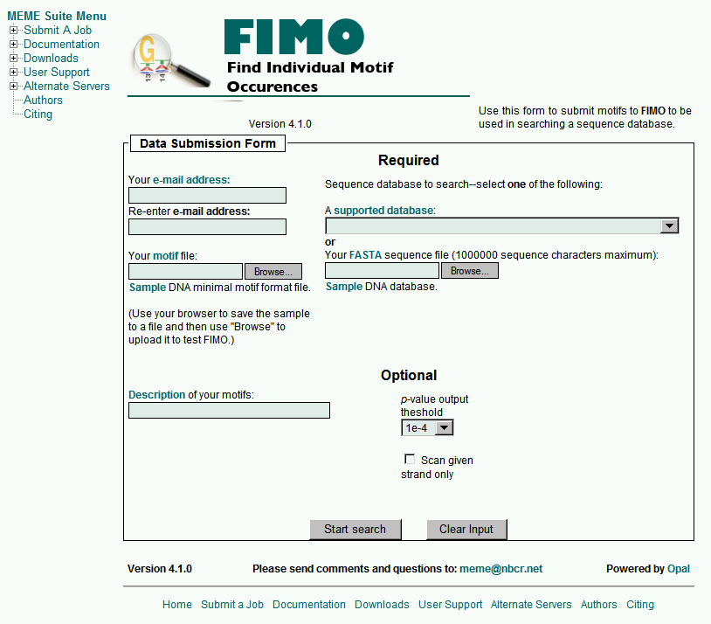

Slide 60
Convert these sequences into a PSSM
AAGTGT
TAATGT
AATTGT
AATTGA
ATCTGT
AATTGT
TGTTGT
AAATGA
TTTTGT
Add a pseudocount.
Convert to frequencies.
Divide by background
Take the logarithm.

Slide 61
Dynamic programming for motif p-values
Motif score
0 | 1 | 2 | 3 | 4 | 5 | 6 | 7 | 8 | 9 | 10 | 11 | 12 | 13 | 14 | 15 | 16 | 17 | 18 | 19 | 20 | 21 | 22 | 23 | 24 | 25 | 26 | 27 | 28 | 29 | 30 | 31 | 32 | 33 | 34 | 35 | 36 | 37 | 38 | 39 | 40 | 41 | 42 | 43 | 44 | 45 | 46 | 47 | 48 | 49 | 50
1
2
3
4
5
Position in motif
 | 1 | 2 | 3 | 4 | 5
A | 10 | 0 | 4 | 6 | 8
C | 2 | 7 | 4 | 8 | 5
G | 5 | 3 | 7 | 10 | 0
T | 8 | 2 | 1 | 0 | 5

Slide 62
Outline
Representing motifs
Motif discovery
Gibbs sampling
MEME
Scanning for motif occurrences
Multiple testing correction

Slide 63
Multiple testing correction
Noble. “How does multiple testing correction work?” Nature Biotechnology 2010.

Slide 64
Types of errors
False positive (type I error): the algorithm indicates that the sequence is a CTCF binding site, but actually it is not.
False negative (type II error): the sequence is a CTCF binding site, but the algorithm indicates that it is not.
Both types of errors are defined relative to some confidence threshold.
Typically, researchers are more concerned about false positives.

Slide 65
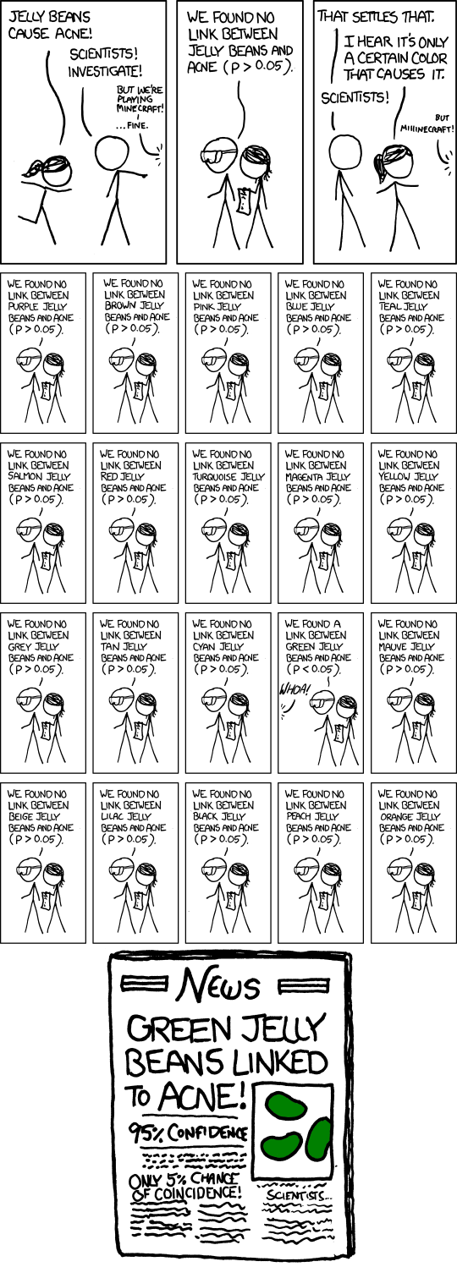

Slide 66
Multiple testing
Say that you perform a statistical test with a 0.05 threshold, but you repeat the test on twenty different observations.
Assume that all of the observations are explainable by the null hypothesis.
What is the chance that at least one of the observations will receive a p-value less than 0.05?

Slide 67
Multiple testing
Say that you perform a statistical test with a 0.05 threshold, but you repeat the test on twenty different observations. Assuming that all of the observations are explainable by the null hypothesis, what is the chance that at least one of the observations will receive a p-value less than 0.05?
Pr(making a mistake) = 0.05
Pr(not making a mistake) = 0.95
Pr(not making any mistake) = 0.95²⁰ = 0.358
Pr(making at least one mistake) = 1 - 0.358 = 0.642
There is a 64.2% chance of making at least one mistake.

Slide 68
Family-wise error rate
For a single test, the Type I error rate is the probability of incorrectly rejecting the null hypothesis.
For multiple tests, the family-wise error rate is the probability of incorrectly rejecting at least one null hypothesis.

Slide 69
Bonferroni correction
How does it work?

Slide 70
Bonferroni correction
Divide the desired p-value threshold by the number of tests performed.
For the previous example, 0.05 / 20 = 0.0025.
Pr(making a mistake) = 0.0025
Pr(not making a mistake) = 0.9975
Pr(not making any mistake) = 0.9975²⁰ = 0.9512
Pr(making at least one mistake) = 1 - 0.9512 = 0.0488

Slide 71
Sample problem
You have scanned both strands of the human genome with a single PSSM, yielding 6 × 10⁹ scores.
You use dynamic programming to assign a p-value of 2.1 × 10⁻¹¹ to the top-scoring match.
Is this alignment significant at a 95% confidence threshold?
No, because 0.05 / 6 × 10⁹ = 8.3 × 10⁻¹².

Slide 72
Proof: Bonferroni adjustment controls the family-wise error rate
Note: Bonferroni adjustment does not require that the tests be independent.
Boole’s inequality
Definition of p-value
m = number of hypotheses
m₀ = number of null hypotheses
⍺ = desired control
p_{i} = ith p-value
Definition of m and m₀

Slide 73
False discovery rate: Motivation
Scenario #1: You have used dynamic programming to identify a new CTCF site that is close to a GWAS hit, and you plan to publish a paper describing this result.
Scenario #2: You have used dynamic programming to discover many potential CTCF sites, and you plan to carry out a CRISPR-based perturbation of these sites. The experiment can be done in parallel on 96 loci.

Slide 74
False discovery proportion
The false discovery proportion (FDP) is the percentage of target sequences above the threshold that are false positives.
The FDR is the expected value of the FDP.
In the context of motif scanning, the false discovery proportion is the percentage of sites above the threshold that are not binding sites.
5 FP
13 TP
33 TN
5 FN
Binding site
Non-binding site
FDP = FP / (FP + TP) = 5/18 = 27.8%

Slide 75
Calculating FDR with an empirical null
“What proportion of the scores above the line are drawn from the null model?”

Slide 76
Family-wise error rate vs. false discovery rate
Bonferroni controls the family-wise error rate; i.e., the probability of at least one false positive among the sequences that score better than the threshold.
The Benjamini-Hochberg procedure controls the false discovery rate; i.e., the expected percentage of false positives among the target sequences that score better than the threshold.

Slide 77
Controlling the FDR
Order the unadjusted p-values p₁ ≤ p₂ ≤ … ≤ p_{m}.
To control FDR at level α,
Reject the null hypothesis for j = 1, …, j*.
Observed p-value at position j
Rank in the list
Significance threshold
Length of the list
(Benjamini & Hochberg, 1995)

Slide 78
Benjamini-Hochberg example
Rank (jα)/m p-value
1 0.00005 0.0000008
2 0.00010 0.0000012
3 0.00015 0.0000013
4 0.00020 0.0000056
5 0.00025 0.0000078
6 0.00030 0.0000235
7 0.00035 0.0000945
8 0.00040 0.0002450
9 0.00045 0.0004700
10 0.00050 0.0008900
…
1000 0.05000 1.0000000
Choose the largest threshold j so that (jα)/m is less than the corresponding p-value.
At most ~5% of the examples above the line are expected to be false positives.

Slide 79
Sometimes the largest example is further down the list …
Rank (jα)/m p-value
1 0.00005 0.0000008
2 0.00010 0.0000012
3 0.00015 0.0000013
4 0.00020 0.0000235
5 0.00025 0.0000945
6 0.00030 0.0002450
7 0.00035 0.0004700
8 0.00040 0.0004715
9 0.00045 0.0004822
10 0.00050 0.0008900
11 0.00055 0.0010205
…
1000 0.05000 1.0000000
Choose the largest threshold j so that (jα)/m is less than the corresponding p-value.
At most ~5% of the examples above the line are expected to be false positives.

Slide 80
Benjamini-Hochberg test
Test of 100 uniformly distributed p-values (p-values from non-significant results)
P-values as blue dots
Significance threshold for FDR = 0.2 as red line
www.complextrait.org/Powerpoint/ctc2002/KenAffyQTL2002.ppt
Notes:
An idealized experiment in which 100 cases, none of which are significant, are tested with the Benjamini-Hochberg procedure, controlling the false discovery rate at 20%. The blue dots are the ranked p-values from the 100 cases, and the red line is the significance threshold established by the Benjamini-Hochberg procedure. None of the cases can be declared significant.

Slide 81
Benjamini-Hochberg test
Test of 10 low p-values (significant results) mixed with 90 p-values from non-significant results
P-values as blue dots
Significance threshold for FDR = 0.2 as red line
Twelve cases declared significant
Declare significant
Notes:
An idealized experiment in which 10 cases with significantly low p-values are mixed with 90 cases that are not significant. All cases can be declared significant up to the highest-ranked case that falls below the significance threshold.

Slide 82
Summary
Selecting a significance threshold requires evaluating the cost of making a mistake.
Bonferroni correction divides the desired p-value threshold by the number of statistical tests performed.
The false discovery rate is the expected percentage of false positives among the target sequences that score better than the threshold.
Use Bonferroni correction when you want to avoid making a single mistake; use Benjamini-Hochberg when you can tolerate a certain percentage of mistakes.

Slide 83
Further reading
Original description of the DP algorithm
Rodger Staden, Methods for calculating the probabilities of finding patterns in sequences, Bioinformatics, Volume 5, Issue 2, April 1989, Pages 89–96, https://doi.org/10.1093/bioinformatics/5.2.89
The Staden paper describes the relevant approach using probability-generating functions, which might be a bit confusing for some.
A more concise and clear summary is
Tatusov RL, Altschul SF, Koonin EV. Detection of conserved segments in proteins: iterative scanning of sequence databases with alignment blocks. Proc Natl Acad Sci U S A. 1994 Dec 6;91(25):12091-5.
A much more detailed description of the approach is given in:
Bailey TL, Gribskov M. Combining evidence using p-values: application to sequence homology searches. Bioinformatics. 1998;14(1):48-54. doi: 10.1093/bioinformatics/14.1.48. PMID: 9520501.
This one might be the easiest to follow. The algorithm is laid out in gory detail on page 51 on the LHS.

